Slide 1



Design – intro OOA/OOD

Slide 2
Today
Class diagram
Object Oriented Analysis and Design

Slide 3
Analysis and design
Object Oriented

Slide 4
Object Oriented Analysis
Program a blinking led, start with Blink (File->Examples->01.Basics-Blink)
FR1: Write a program that blinks a LED with f₁ = 2 Hz (250 ms on, 250 ms off)
FR2: Add a 2nd LED with f₂ = 1 Hz
FR3: Add a 3rd LED with f₃ = 4 Hz
FR4: change of frequencies: f₁ = 0.2 Hz, f₂ = 3 Hz, f₃ = 5 Hz
you have 2 minutes!
Notes:
Before we start off we’re doing this Arduino excersise.
Stimulate students towards most simple solution. For FR4: do let them think a bit, but don’t let them implement it

Slide 5


Object Oriented Analysis
Another approach
Which objects do we have?
What are the operations?
What should be the class?
Notes:
In interaction with classroom, discover the objects that are involved. We’ll draw them on the whiteboard
Then we talk about the classes that are involved, also draw them on the whiteboard.
Please steer towards a “one class” solution: LED (that also includes timing)

Slide 6
Object Oriented Analysis 2
The LED class has 2 responsibilities
switching the LED
computing timing
Change to: a separate Timer class
It can be started with a time.
The timer can be queried if the timeperiod has elapsed.
Notes:
We will have a timer class, discuss with classroom what methods it should have
About the separate Timer class: do mention that a class should have only 1 responsibility.

Slide 7
Object Oriented Design
Are we now done?
How will our LED solution work? Or more precisely: when?
How do we solve this?
OOA: thinking about what is needed to solve our problem
OOD: thinking about how our solution is going to work (together)
Notes:
OOA consist of:
Object modelling: identify the objects, the classes into which the objects can be grouped into and the relationships between the objects, as well as the main attributes and operations that characterize each class.,
Dynamic modeling: behavior with respect to time and external changes,. The dynamic model corresponds to the data flow diagram.
Functional Modeling : identify the processes that are performed within an object and how the data changes as it moves between methods; give In the meaning of the operations of object modelling and the actions of dynamic modelling. The functional model corresponds to the data flow diagram.

Slide 8
Class diagrams or Modeling a System’s Logical Structure
Recap & new relations

Slide 9
Classes are at the heart of the OO approach
- Use cases describe the behavior of your system as a set of concerns.
- But a system’s structure is made up of a collection of objects.
- Classes describe the different types of objects that are needed within the system to meet those concerns

Slide 10
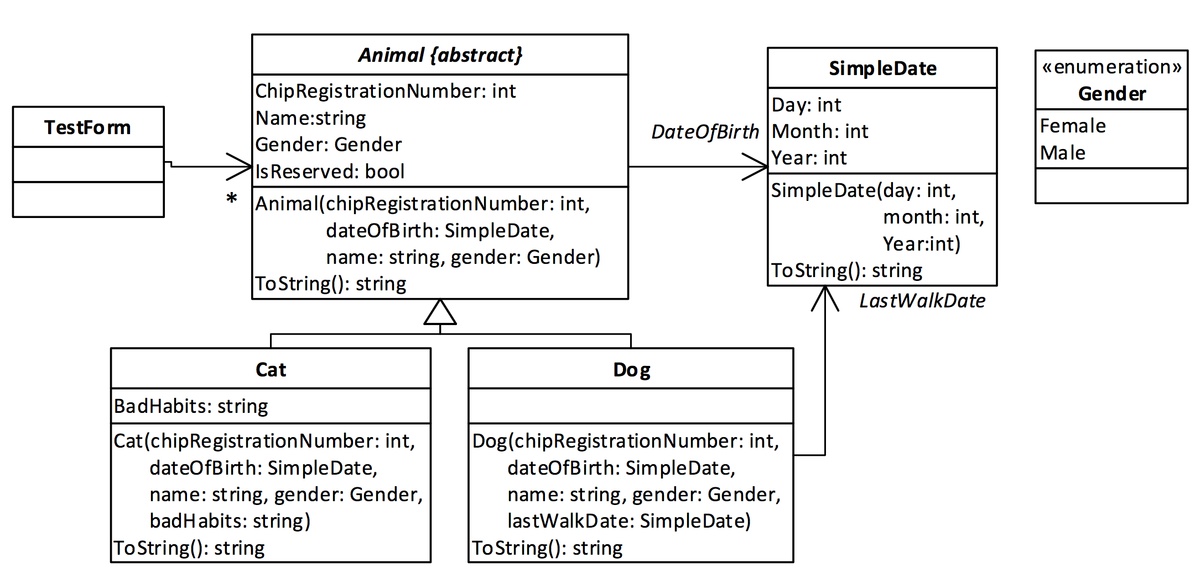
Sem2:

Slide 11
Classes do not live in a vacuum—they work together using different types of relationships.
- Classes can have relationships to one another
- A class can be a type of another class—generalization—or
- A class can contain objects of another class in various ways depending on how strong the relationship is between the two classes.

Slide 12
Class diagram artifacts:
Visibility Methods & Members (public, protected, private)
Dependency
Associations:
Navigation direction
Multiplicity
Shared
Composition
Inheritance
Realisation

Slide 13
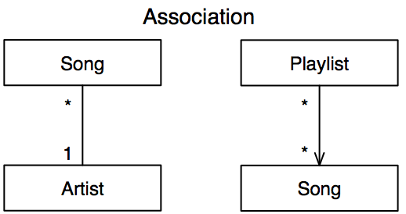
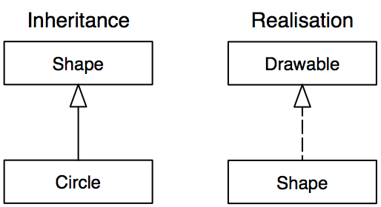
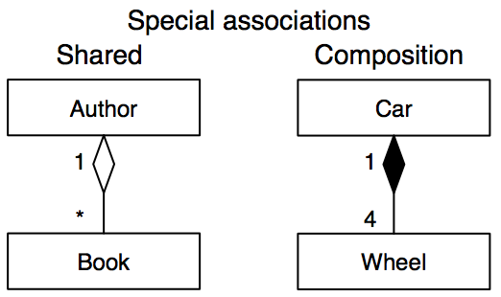
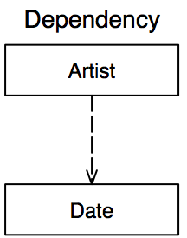
Classes relations:
*
*) UML@Classroom talks about Aggregation, which is an older term for the same thing
Notes:
In OOP2 you only learned the 4 relations in the top 2 squares, in this course you will learn the other relations as well.
Shared association was formerly known (UML1 standard) as aggregation, we prefer the much clearer name shared association.

Slide 14
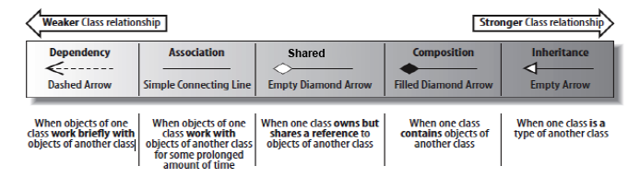
Class Dependencies:
Dependency
Association
Composition
Aggregation
Inheritance
Fig. 5.1 – Learning UML 2.0

Slide 15
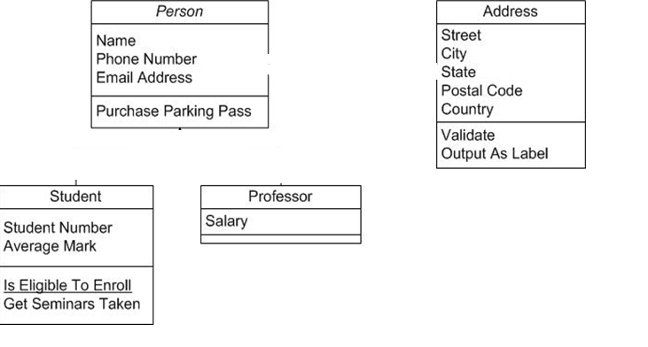
Example Class Diagram

Slide 16
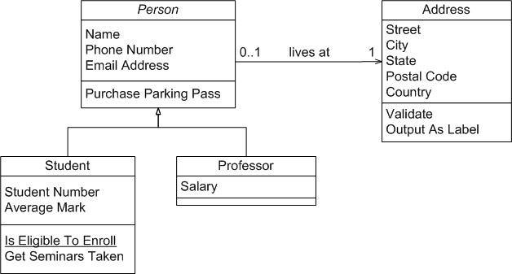
Example Class Diagram

Slide 17
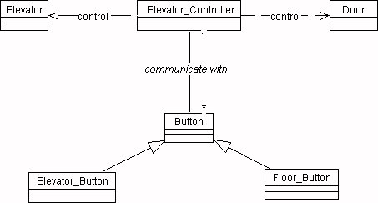
Example Class Diagram

Slide 18
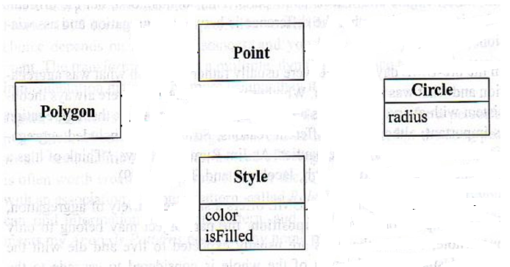
Example Class Diagram

Slide 19
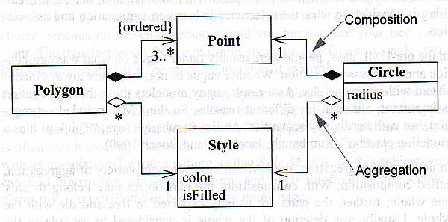
Example Class Diagram
Notes:
Figure shows examples of aggregation and composition constructs.
The compositions to Point indicate that any instance of Point may be in either a Polygon or a Circle, but not both. An instance of Style, however, may be shared by many Polygons and Circles. Furthermore, this implies that deleting a Polygon would cause its associated Points to be deleted, but not the associated Style.
This constraint that a Point may appear in only one Polygon or Circle at a time could not be expressed by the multiplicities alone. It also implies that the point is a value object. You can add a 0..1 multiplicity to a composite side of the association, but it is not that necessary because the black diamond says all that needs to be said.
http://etutorials.org/Programming/UML/Chapter+6.+Class+Diagrams+Advanced+Concepts/Aggregation+and+Composition/

Slide 20
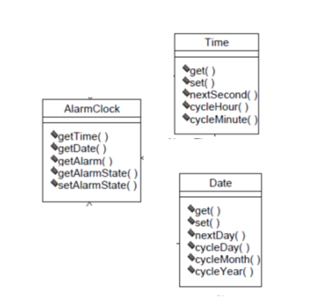
Example Class Diagram

Slide 21
Example Class Diagram

Slide 22
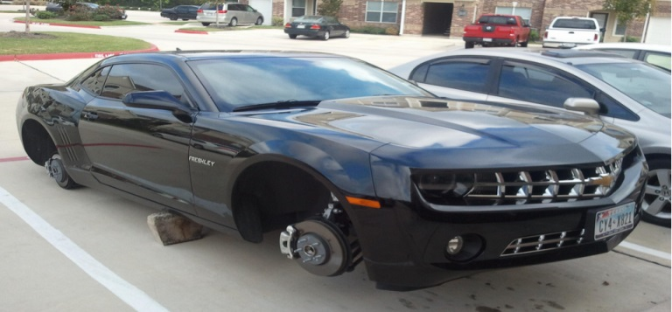


Examples of depencies?
Still a car?
Author can exist without ‘My really great book’.
Man depends on it…

Slide 23
Text analysis
A software house (Interstar) is divided in departments.
Each department has a name (software development, management, etc.) and an annual budget.
Various employees work in the departments.
Every employee has a unique identifier, a name and a salary.

Slide 24
Class diagram – 1st try
Softwarehouse
name
is divided in
1..*
Department
Person
ID
name
salary
year budget
name
is employed by
employee

Slide 25
More associations between classes
In principle, a department has a department manager. Sometimes a department is temporarily without a manager. A manager is the head of one department
is head of
manager
0..1
0..1
Department
Person
ID
name
salary
year budget
name
is employed by
employee

Slide 26
Unary association
Within a department there is a hierarchical structure. Each employee manages 0 or more employees.
is head of
manager
0..1
0..1
Department
Person
ID
name
salary
year budget
name
is employed by
employee
0..1
0.*1
project leader
project developer

Slide 27
Candidate classes in a domain model
Make a list of candidate classes.
Underline the nouns that represent something from the domain. (better too much than missing some)
In interviews
In background information
In job descriptions
In scenarios
In use cases
……
any other information that you gather about the domain and/problem

Slide 28
Make choices
Remove the irrelevant candidates based on the following criteria:
out of the scope
Refers to the system as a whole
Duplicate of another class
Too vague
Too specific (becomes object)
Is input/output for the system
Is an attribute of a class
Is an operation of a class
Is a relationship between classes that is not a class in itself.

Slide 29
How do you find classes?
Report of interview with librarian
The library is an organization that lends copies to members.
Anyone can become a member of the library. All members are registered on the name-and-address details and date of birth.
Example: for the member: Jan Pietersen, the name-and-address details and
date of birth are registered.
An employee of the library carries out all registration.
Students are an important group-members.
There are several copies of each book.
If a copy is not in stock, a reservation can be made.
When you borrow a copy, you receive a receipt on which the deadline return date is stated. The loan period is linked to the loan. When returning an item, a
return check must be made.

Slide 30
Candidate classes
Examples of candidate classes
Organization: library.
Structures: deadline return date, date of birth
Physical things: book, receipt.
Abstraction of persons: student, member, employee, borrower.
Abstraction of physical things: item, copy.
Concepts: loan, reservation.
Temporary relations between above mentioned classes : borrowing :(copy-member)

Slide 31
Examples analysis
whole system
member |  |  | library
employee |  |  | student
receipt with reurn day |  |  | return check
copy |  |  | borrower
matter |  |  | book
reservation |  |  | loan
loan period |  |  | date of birth
class
out of scope
duplicate of memb.
output
operation
duplicate of memb.
class
class
Too vague
class
class
out of scope
attribute

Slide 32
Improve and describe
Check whether all classes are sufficiently abstract.
Tool: make up more instances
Briefly describe the most characteristics of the class in the data model dictionary
What does the class do for the user.
What attributes does the class have.
What operations does the class have.

Slide 33
Relations between classes: -mediatheek-
Loan
Copy
returnday
.....
Copy.-number
.....
Member
ID info birthday
.....
Book
Reservation
.....
Title
ISBN number
.....

Slide 34
Search reationships
Find associations (relationships) between classes
Verbs often indicate relationships between classes.
E.g. “a borrower may only borrow 5 copies”
View the possible interaction between all the different classes
Many relationships are obvious.
At a later stage there is another possibility (sequence diagram) to find more relationships.

Slide 35
Relations between classes
Loan
returnday
.....
Copy
0..5
0..1
regarding
Copy.-number
.....
has
1
Member
of
ID info birthday
.....
1
1
1
Book
asked
1
Title
ISBN number
.....
Reservation
for
.....
*
*

Slide 36
Improve and describe
Ask specific questions about multiplicity, eg. How many copies can borrower borrow?
Draw the classes and associations in a Class diagram
Give each association a name
Fill in the multiplicity otherwise it is a 1:1 relationship.

Slide 37
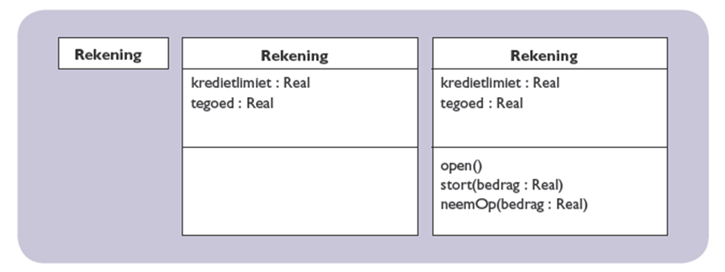
Example
Account
Account
Account
credit limit: Real balance: Real
credit limit: Real balance: Real
open() deposit(amount: Real)
withdraw(amount: Real)
A class with attributes and operations

Slide 38
employee
employer
Company
Person
workingAt
Person
employee
employer
Company
hasInService
employee
employer
Company
Person
workingAt
chairman
Club

Slide 39
Examples
Car
transports
Person
Car transports exactly one Person
passenger
Car
transports
5
Person
passenger
Car transports exactly five Persons
Car
transports
*
Person
Car transports zero or more Persons
passenger
Car
transports
1..*
Person
Car transports one or more Persons
passenger
Car
transports
2..5
Person
passenger
Car transports two to five Persons

Slide 40
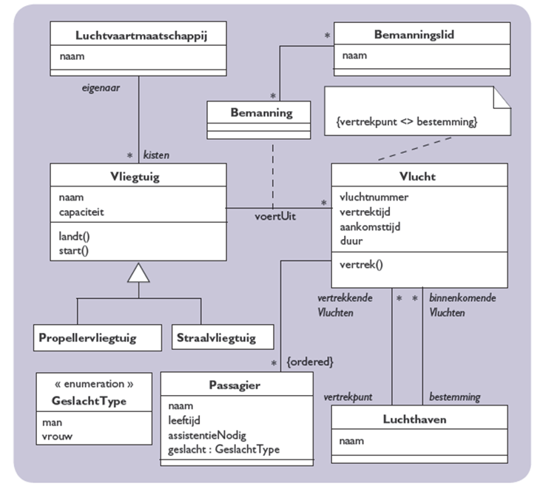

Slide 41
Creating a class diagram
You have learned in Sem2 how to start with creating a class diagram.
If you need refreshment: consult UML@Classroom (§4.9)
Be sure to refresh your memory!
Take a look at the Project 1: Use cases, requirements, state machines and sequence diagrams
Notes:
The “deciding what classes you have” is object oriented analysis, do not forget the design part!

Slide 42
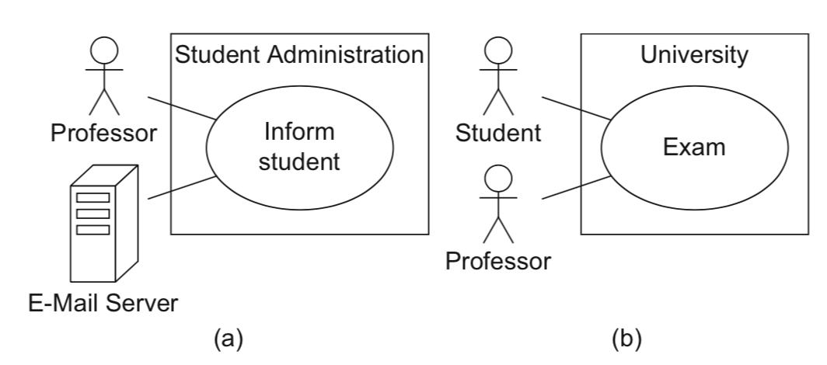
UML@Classroom: Use Case diagram
Notes:
What does a use case diagram look like again…

